Slide 1
Breakout

Slide 2
1972
1976
Notes:
1973 the first

Slide 4
Over 10,000 students
Due in week 5 of CS106A

Slide 6
Big program. Do it in parts
1
2
3

Slide 7
getCollidingObject
4
GObject collider =
getElementAt(x, y);
null
,
,
a brick

Slide 10
Pro Tips
Want to wait for a click to start? Use waitForClick()
Do not animate in mouse moved!
Use instance var for paddle.
Make sure to test as you go. Program one milestone at a time.
No instance variable for bricks

Slide 11
How do you know if you hit a brick?
4
GObject collider =
getElementAt(x, y);
null
,
,
a brick

Slide 12
Aside: Secret to how
memory really works

Slide 13
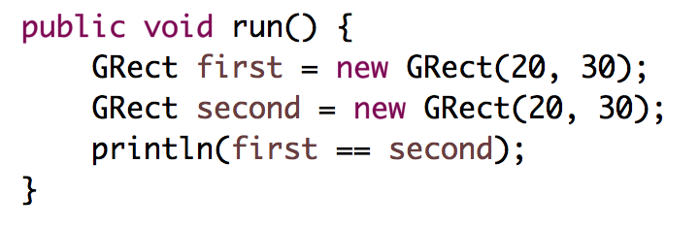
Who thinks this prints true?
public void run() {
int x = 5;
int y = 5;
println(x == y);
}
Notes:
true

Slide 14
Who thinks this prints true?

Slide 15
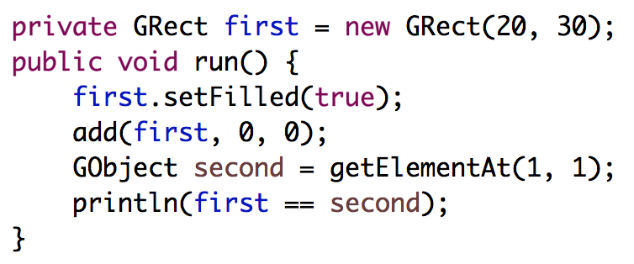
Who thinks this prints true?

Slide 16
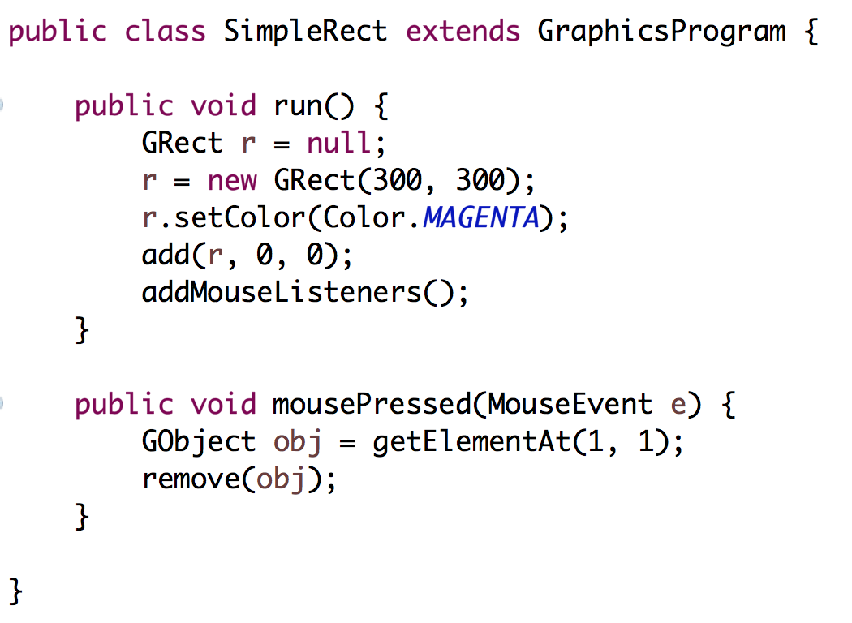
Stack Diagrams
public void run() {
println(toInches(5));
}
private int toInches(int feet){
int result = feet * 12;
return result;
}
run

Slide 17
Stack Diagrams
public void run() {
println(toInches(5));
}
private int toInches(int feet){
int result = feet * 12;
return result;
}
run

Slide 18
Stack Diagrams
public void run() {
println(toInches(5));
}
private int toInches(int feet){
int result = feet * 12;
return result;
}
f
run
toInches
feet
5

Slide 19
Stack Diagrams
public void run() {
println(toInches(5));
}
private int toInches(int feet){
int result = feet * 12;
return result;
}
f
run
toInches
feet
5
result
60

Slide 20
Stack Diagrams
public void run() {
println(toInches(5));
}
private int toInches(int feet){
int result = feet * 12;
return result;
}
f
run
toInches
feet
5
stack
result
60

Slide 21
Stack Diagrams
public void run() {
println(toInches(5));
}
private int toInches(int feet){
int result = feet * 12;
return result;
}
f
run
60

Slide 22
Aside: Actual Memory

Slide 23
What is a bucket
feet
5

Slide 24
What is a bucket
feet
1011100111100011
0011010110010100
* Each bucket or “word” holds 64 bits
** don’t think on the binary level (yet)

Slide 25
variables have fixed size buckets to store values

Slide 26
Primitives vs Classes
Primitive Variable Types
Class Variable Types
int
double
char
boolean
GRect
GOval
Gline
Color
Class variables (aka objects)
Have upper camel case types
You can call methods on them
Are constructed using new
Are stored in a special way

Slide 27
Primitives vs Classes
Primitive Variable Types
Class Variable Types
int
double
char
boolean
GRect
GOval
Gline
Color
aka
Objects
Class variables (aka objects)
Have upper camel case types
You can call methods on them
Are constructed using new
Are stored in a special way

Slide 28
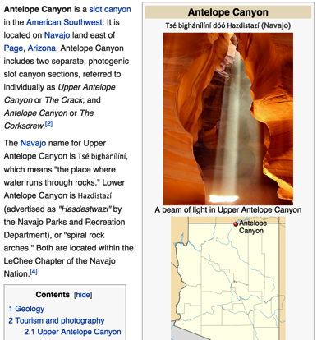
How do you share wikipedia articles?
Antelope Canyon Article
Key:
https://en.wikipedia.org/wiki/Antelope_Canyon

Slide 29
public void run() {
GImage img = new GImage(”mountain.jpg”);
add(img, 0, 0);
}
stack
heap
run

Slide 30
public void run() {
GImage img = new GImage(”mountain.jpg”);
add(img, 0, 0);
}
stack
heap
run

Slide 31
public void run() {
GImage img = new GImage(”mountain.jpg”);
add(img, 0, 0);
}
stack
heap
run

Slide 32
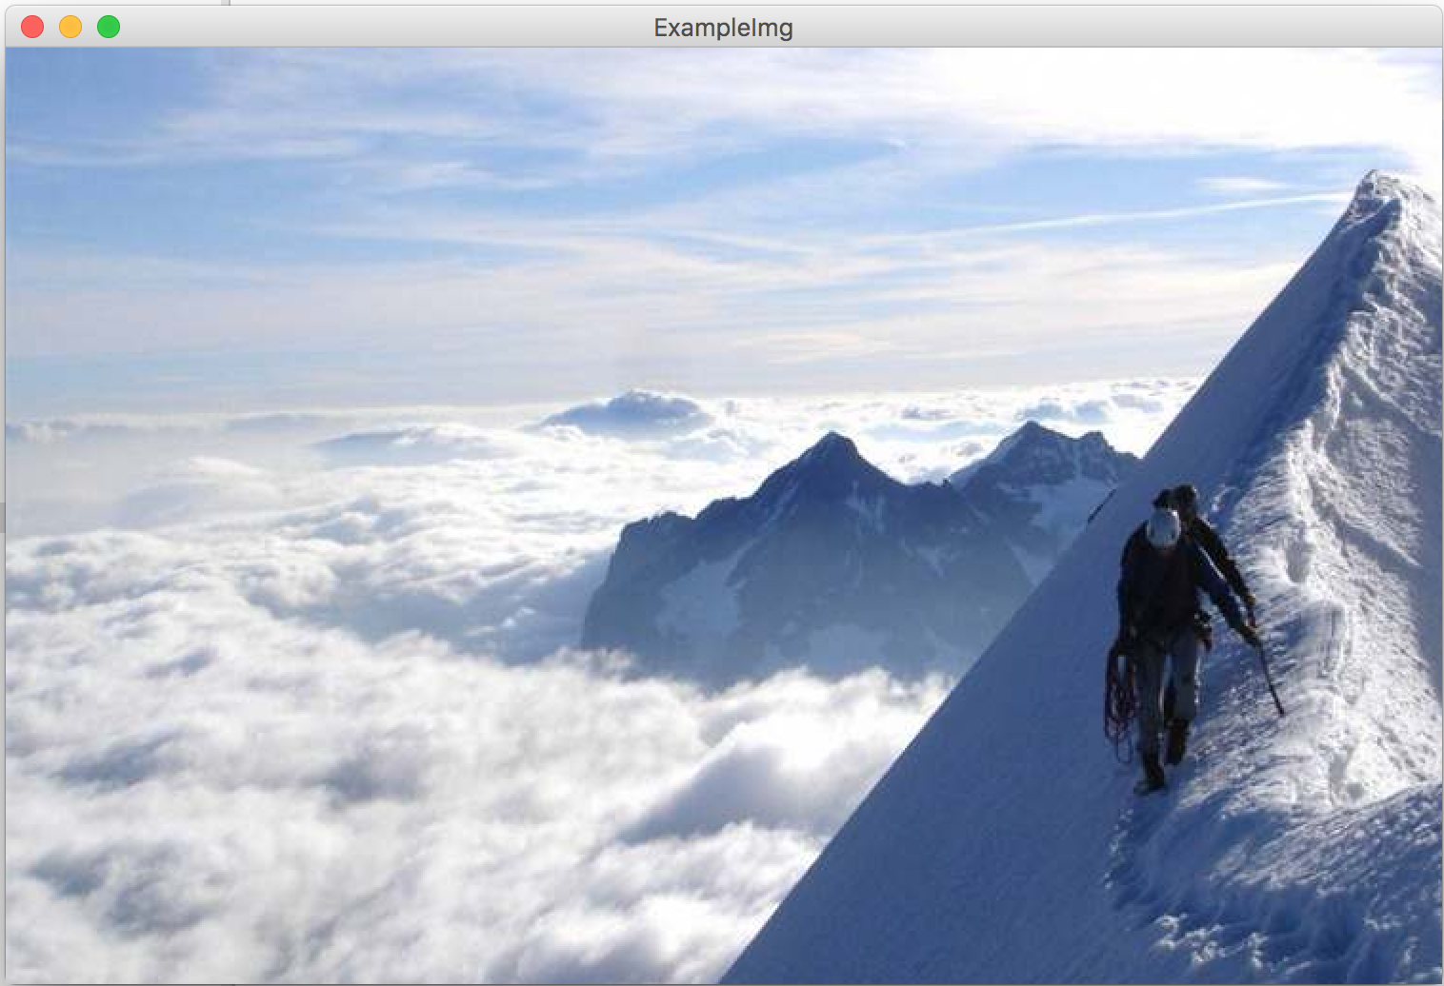
public void run() {
GImage img = new GImage(”mountain.jpg”);
add(img, 0, 0);
}
stack
heap
run

Slide 33
public void run() {
GImage img = new GImage(”mountain.jpg”);
add(img, 0, 0);
}
stack
heap
42
run

Slide 34
public void run() {
GImage img = new GImage(”mountain.jpg”);
add(img, 0, 0);
}
stack
heap
42
run
img

Slide 35
public void run() {
GImage img = new GImage(”mountain.jpg”);
add(img, 0, 0);
}
stack
heap
42
run
img
42

Slide 36
public void run() {
GImage img = new GImage(”mountain.jpg”);
add(img, 0, 0);
}
stack
heap
42
run
img
42

Slide 37
public void run() {
GImage img = new GImage(”mountain.jpg”);
add(img, 0, 0);
}
stack
heap
42
run
img
42

Slide 38
public void run() {
GImage img = new GImage(”mountain.jpg”);
add(img, 0, 0);
}
stack
heap
42
run
img
42

Slide 39
public void run() {
GImage img = new GImage(”mountain.jpg”);
add(img, 0, 0);
}
stack
heap
42

Slide 41
Who thinks this prints true?

Slide 42
Who thinks this prints true?
memory.com/18

Slide 43
Who thinks this prints true?
memory.com/18

Slide 44
Who thinks this prints true?
instance vars
memory.com/18
first
18

Slide 45
Who thinks this prints true?
instance vars
memory.com/18
first
18

Slide 46
Who thinks this prints true?
instance vars
memory.com/18
first
18
run

Slide 47
Who thinks this prints true?
instance vars
memory.com/18
first
18
run

Slide 48
Who thinks this prints true?
instance vars
memory.com/18
first
18
run

Slide 49
Who thinks this prints true?
instance vars
memory.com/18
first
18
run

Slide 50
Who thinks this prints true?
instance vars
memory.com/18
first
18
run
second
18

Slide 51
Who thinks this prints true?
instance vars
memory.com/18
first
18
run
second
18

